Slide 1

Languages Of Genes
Bairagi Nath Behera
Nitish Rawat
Sambhav Sharma

Slide 2
Introduction
In the same decade when DNA structure and genetic code for gene expressions were discovered Chomsky came out with his work on Formal Languages.
Chomsky's work was based on the fact that we have infinite languages based on finite characterstics.
As DNA and other biological sequences are richly expressive we can try to have a link between them and Formal languages.

Slide 3
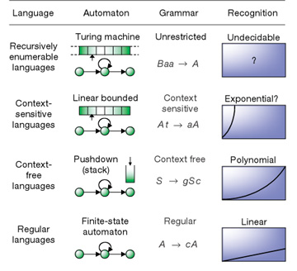
Chomsky Hereiachy

Slide 4
Little More Terms
Ambiguity- Two ways to reach a string
Indexed Languages- Apart from Chomsky's basic languages, little modified one.
Lindenmayer Systems- System for biological sequences based on IL
Closure Properties and Decidability

Slide 5
Nucleiotide Linguistics
Structural Linguistics :
Linguistic power required to encompassvarious phenomena observed in nucleic acids based on their structure.
Functional Linguistics :
Linguistic power required based on the various information structure on basis of the different functions.

Slide 6
Simple DNA helix
ΣDNA = { g, c, a, t }
Now, in our grammar we want the compliments of various base pair.
Using simple regular expression we can inherit a string and then find it's complimentary strand.
But this power isn't enough in cases we generally require in nucleiotides, RNA and proteins.

Slide 7
Nucleic Acids Are not Regular
Inverted repeats are prevalent features of nucleic acid.
This implies that thesubstring and its reverse complement are both to be found on the same strand, which can thus fold back to base-pair with itself and form a stem-and-loop structure.
Such base-pairing within the same strand is called secondary structure.
Hence to do that we may be needing a CFL.

Slide 8
CFL for Nucleiotides
S → bSb' | A
A → bA | ε
where b ∈ ΣDNA
This structure may seem to be over as on with regular languages but no it fails as it requires a stack power because it's almost the same case as of we see in palindromes.

Slide 9
Nucleic Acids aren't CFL
As we saw in last way , it's for the structure that is Ideal.
Ideal structure means having same number of complement strings present as of base.
The illustration is that a string of direct repeats extending infinitely in either direction could shift an arbitrary number of times, and still maintain base-paired structure with its reverse complementary string through alternative “hybridization.”
This make us move our grammar beyond CFL.
.

Slide 10
Nucleic Acids as Indexed Languages
The features described thus far are all encompassed by CSLs with ε, and in fact can be described by indexed grammars, which specify the IL subset of CSLs.
S → bS^{b} | A
A^{b} → Ab
A→ ε

Slide 11
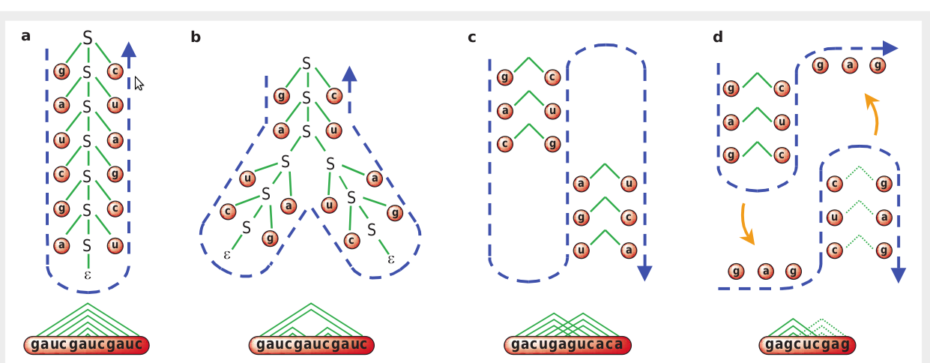
Grammar style derivations

Slide 12
SO..
Using formalisms called tree-adjoining grammars which are considered to be mildly context-sensitive and relatively tractable, it is possible to encompass a wide range of RNA secondary structures.
Natural languages seem to be beyond context-free as well, based on linguistic phenomena entailing cross-serial dependencies.
Thus by one measure nucleic acids may be said to be at about the same level of linguistic complexity as natural human languages.

Slide 13
Protein Linguistic
There has been less activity in modelling proteins with linguistic methods, perhaps because they are viewed as having a richer basic interactions and conformations than nucliec acid.
Specific aspects of protein structure have been modelled explicitly with grammers. Secondary structural elements and in particular the hydrogen bonding between strands in a β-sheet may be arranged in antiparallel fashion or in parallel fashion. Such arrangements have been represented using stochastic tree grammer.

Slide 14
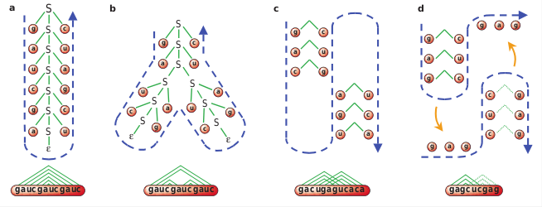
Protein Linguistic
Grammar-style derivations of idealized versions of RNA structures. a, A stem; b, a branched structure; c, a pseudoknot; and d, alternative secondary structures of an attenuator. The trees for a and b are graphical depictions of derivations from grammars given in the text. By convention, a starting nonterminal S is at the root of the tree and gives rise to branches for each symbol to which it rewrites in the course of the derivation. The string derived can be read by tracing the frontier or leaf nodes of the tree, left to right (dashed blue lines). For c and d, derivation trees are not explicitly indicated because of the complexity of the context-sensitive grammars required7. The same strings are also shown in linear fashion, with dependencies indicated between terminals derived at the same steps.

Slide 15
Protein Linguistic
Mathematicians are concerned with closure properties of language, that is, whether they remain at the same level of the Chomsky hierarchy.
Simple concatenation of strings is a so-called regular operation, whereas insertion of string in another is a context-free operation.
However, translocation of segments of a string may constitute an upward force in the Chomsky hierarchy that is inherent in evolution.

Slide 16
Protein Linguistic
Greater richness of the language of genes and proteins indicates all the more the need for a well-founded descriptive paradigm.
This view will also allow us to expand our horizons beyond the relatively local phenomena of secondary structure, to large regions of the genome. This will allow us in turn to reason linguistically about processes of evolution.

Slide 17
Computational linguistics and genes
The results summarized above all relate to structural aspects of macromolecules and independent of any information they contain.
Language process is often conceived as proceeding from (1) the lexical level, (2) the syntactical level (3) the semantic level, (4) the pragmatic level.

Slide 18
General purpose parsers
There is advantage of flexibility
Cannot compete in efficiency with programming that is customized to a particular domain
A dominant technique in the analysis of biological sequences is Hidden Markov Model (HMM)

Slide 19
Hidden Markov Model
A variety of automaton with probability value that governs its behaviour.
Firstly, widely deployed for speech recognition.
More recently have found their way into a number of application for the analysis of biological sequences.

Slide 20
Evolutionary Linguistics
. Evolution
. Application of Grammers for evolutionary linguistics.
. in 1786, Darwins first proposed for evolutionary
linguistics.
.

Slide 21
Repetition and Infinite languages
Problem on RL
. if the string is greater then no.of states of FA
. if the string is less then no.of states of FA
Problem on CFL
.unbounded duplications strings
Move towards to CSL

Slide 22
Mutation and Rearrangement
change evolution—duplication, inversion, transposition, and deletion
DUP(L) = { xuuy | xuy ∈ L}
INV(L) = { xu^{-R} y | xuy∈L}
XPOS(L) = { xvuy | xuvy∈L}
DEL(L) = { xy | xuy∈L}

Slide 23
Mutation and Rearrangement cont..
definite clause grammar (DCG)
Mutation :-
point_mutation([From],[To]).
(_, point_mutation(X,Y), _) ==> Input/Output.
Rearrangements :-
duplication, X, X --> X.
inversion, ~X --> X.
transposition, Y, X --> X, Y.
deletion --> X.
Evolution :-
evolution --> [ ] | event, evolution.
event, X --> X,
(inversion | deletion | transposition | duplication)

Slide 24
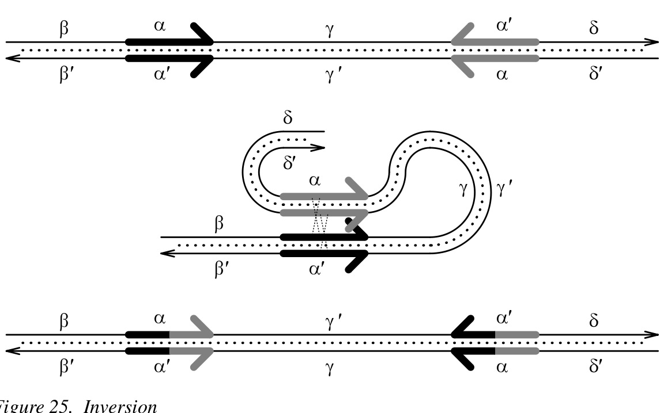

Inversion

Slide 25
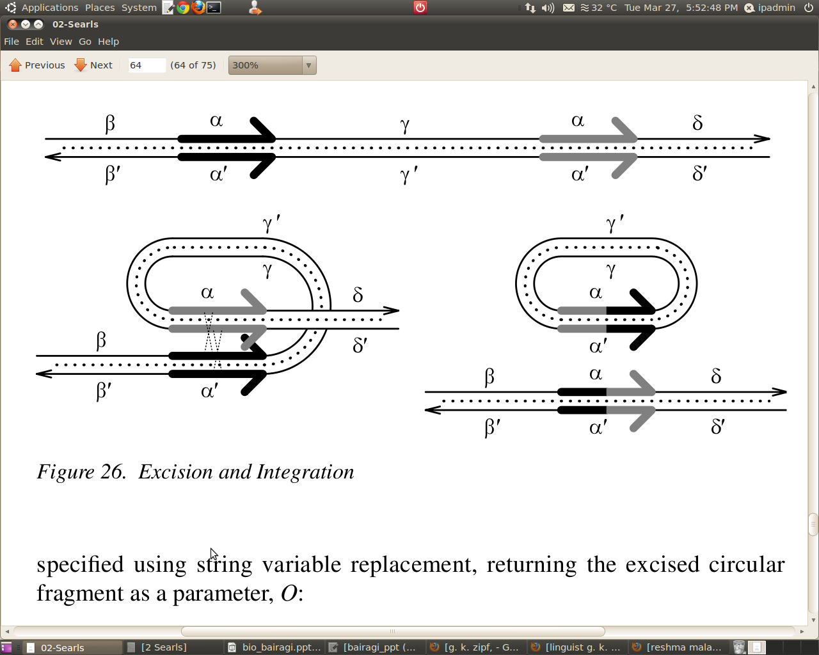
Excision and Integration

Slide 26
DCG for Excision and Integration
Excision
excision(O), S --> S, X, S,
{(S,X)==>O/O}.
Integration
integration(O), S, X, S --> S,
{(_,S,X,S,_)==>O/O}.

Slide 27
Comparison of Strings
based on the detection of similarities between strings, rather than between a pattern and a string.
“gaataattcggctta”$Cost ==> “gacttattcgttagaa”
We can implement this as a DCG:
[ ]$cost --> [ ]. % zero cost
[H|T]$Cost --> [H], % bases match; zero cost
[H|T]$Cost --> [X], % cost one
[_|T]$Cost --> T$Ins, % Cost is Ins+1
String$Cost --> [_], String$Del, % {Cost is Del+1}.
Prolog “bagof” operation
best(From$Cost ==> To)
bagof(Cost,(From$Cost ==> To),Bag),
minimum(Bag,Cost).

Slide 28
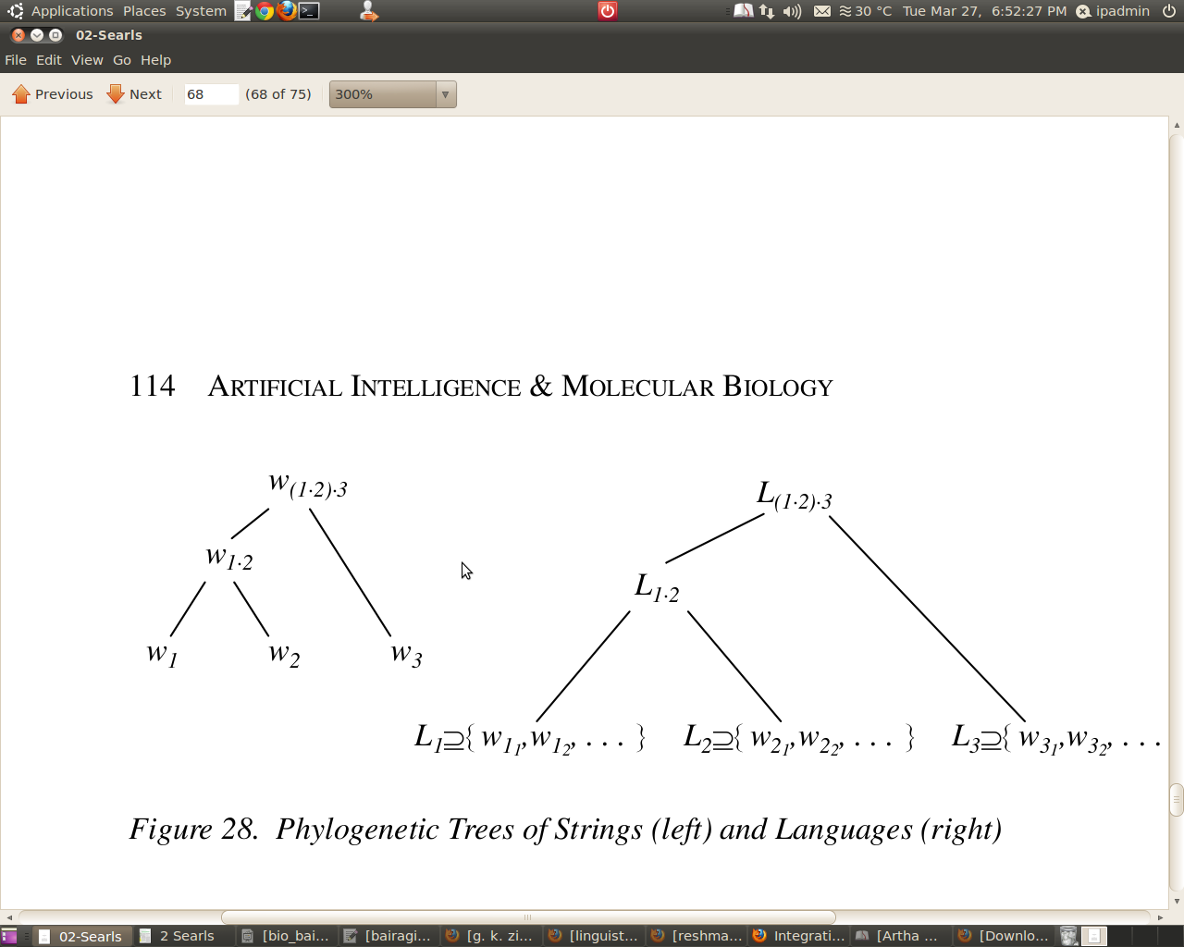
Phylogeny of Languages

Slide 29
Conclusion
Parse trees may reflect secondary structure
Grammar nonterminals might model biochemical entities
Grammar rules could describe intra-molecular interactions
Greater-than-context-free grammars can model mutation and evolution
Grammar derivation could model gene expression.
Parsing might mimic certain biochemical processes

Slide 30
References
The language of genes - David B. Searls, Bioinformatics Division, Genetics Research, GlaxoSmithKline Pharmaceuticals.
The Computational Linguistics of Biological Sequences - David B. Searls

